Slide 1
How can I help my child to revise?

Slide 2
Year 11 Dates for Your Diary
2022
English (only) PPEs: 14th November 2022
‘Make It Work’ Day: 16th November 2022
Progress Report 1: 2nd December 2022
Parents’ Evening: 8th December 2022
2023
PPEs: 9^{th-}17th January 2023
Year 11 Spirituality Day: 18th January 2023
Progress Report 2: 10th February 2023
Y11 Form Tutor Reviews: February 2023

Slide 3
Revision and self study: Why is it important to start now?
Time! PPE examinations commence 9th January 2023
It is not helpful to ‘begin’ revision over the Christmas period. It should be well established by then to ease the workload
The COVID ‘gap’ – it still exists
Good study habits and revision skills need to be learned

Slide 4
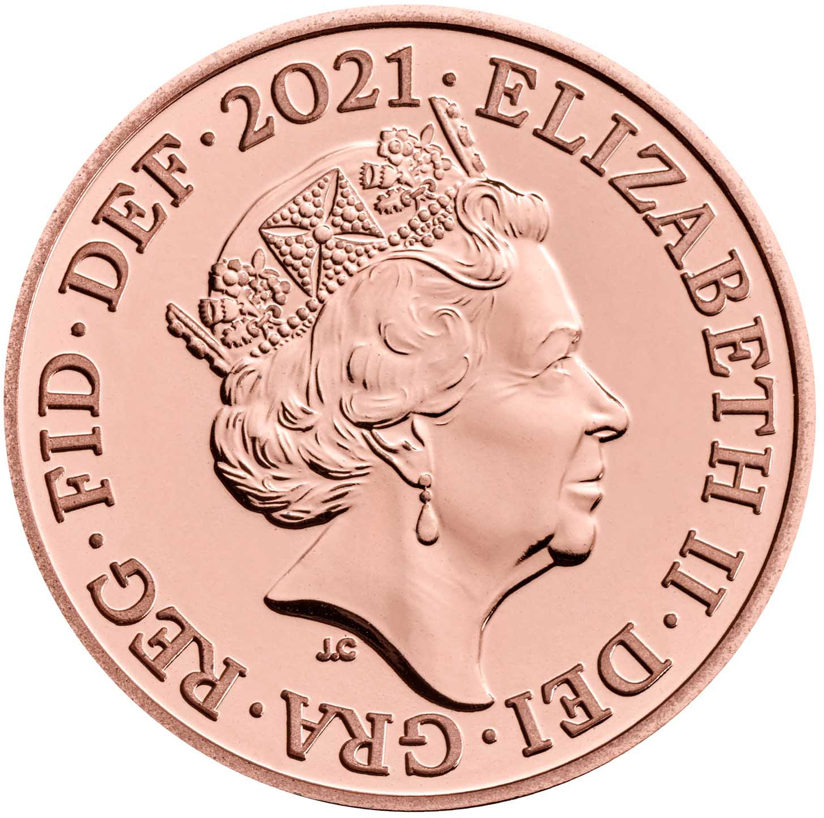
In the 1970s, a series of experiments were done to determine how completely and accurately people remembered the visual details of a common object, a United States penny (Nickerson and Adams, 1979). The findings were that the participants recall of the details was very poor despite having seen pennies many hundreds of times in their lives.
If you ask a student to recall the details of a common object (e.g. a penny) from memory, the majority will be unable to do so accurately, stating that they have “forgotten” those details. In fact, they didn’t forget the details – they never learnt the information in the first place.
To remember something accurately, students need to engage in controlled processing:
Over time
Different learning strategies suit different students
Distractions must be blocked out
Learn to focus on the task at hand
THESE HABITS CAN BE FORMED FROM NOW

Slide 5
What can you do as parents?
Study space
provide a quiet, appropriate, comfortable and distraction-free area for them to study in
Take their phone during study time
This is THE biggest distraction to students. Where possible, phones should not be used as part of revision or study. Use an alternative means to access anything needed online
Allocate time for study
Help your child to draw up a revision timetable. This should be AGREED with them, not forced upon them (see next three slides)
Quiz / test to improve recall
Be active in your child’s revision - incorporate brief tests or quizzes into revision, and encourage students to self-test as they study. Reading a passage and then stopping to ask students what they just read is going to be more effective than reading it twice (Roediger and Karpicke) (2006)
Check homework – Synergy!
Hard work gets grades. Students that spend at least two hours a night on their homework/revision are statistically more likely to get better grades.
Make sure your child knows they are accountable not only to their teacher, but also to you as their parent. Working as a team, we can help them to get the most out of school.
Notes:
.

Slide 7
Revision Timetable
This is an example. Revision timetables must be tailored to the individual. 30-45 minutes in each session is a sensible expectation, then a break. Build revision up over time - it has to be sustainable.
 | Date | 3:15-4:15pm | 4:15-5:15pm | 5:15-6:15pm | 6:15– 7:15pm | 7:15-8:15pm | 8:15-9:15pm
Monday |  | Duke of Edinburgh @school | Get home Tea time | Homework! then PE | Geography | English Language | Wind down before bed (Avoid your phone!)
Tuesday |  | Get home Snacktime Homework! | English Lit | Tea time | Maths | History | Wind down before bed (Avoid your phone!)
Weds |  | History Revision session @school | Get home Tea time | Homework! then Science | Football | PE | Wind down before bed (Avoid your phone!)
Thursday |  | Maths revision session @ school | Get home Tea time | Homework! then English Language | English Lit | Geography | Wind down before bed (Avoid your phone!)
Friday |  | 2:15-3:15pm Get home Snacktime Homework! | 3:15-4:15pm RE | 4:15-5:15pm Science | Friday Night Off

Slide 8
Weekend Revision Timetable
 | Date | Morning Session 9am-12pm | Afternoon Session 1pm-5pm | Evening
Saturday |  |  |  | Relax! Family time! Friends! You-time!
Sunday |  |  |  | Relax! Family time! Friends! You-time!

Slide 9
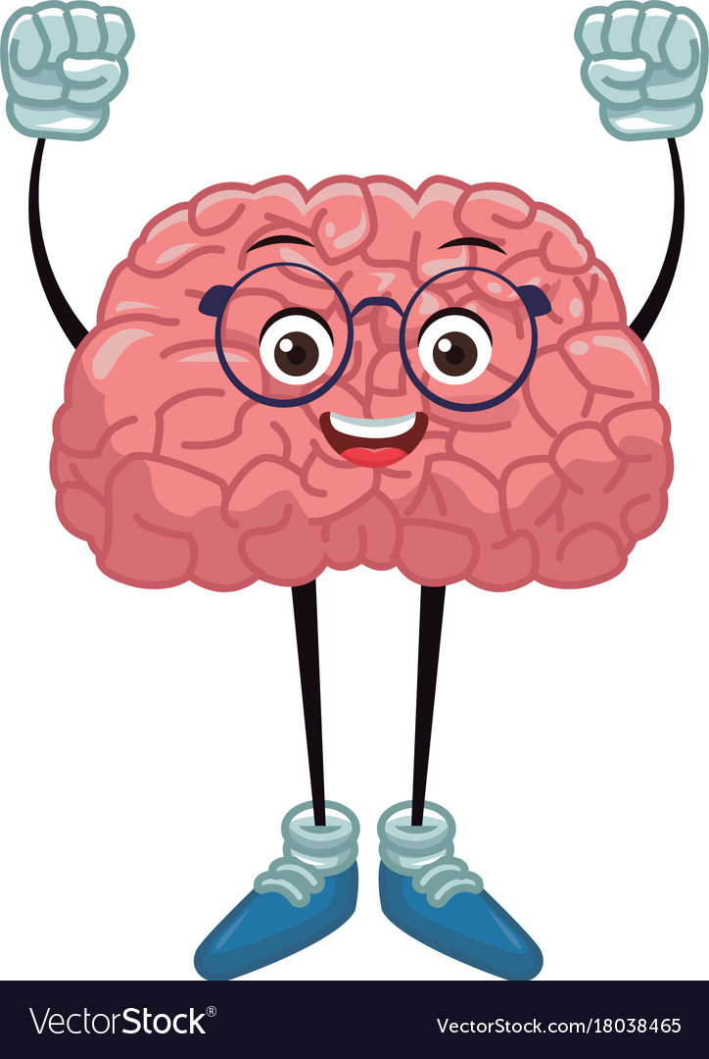
Revision timetable: Top Tips!
Keep your brain ENGAGED by keeping your revision VARIED
Include a good mix of subjects every day – don’t spend an entire evening (or week!) on one subject.
Revision MUST be split into manageable chunks with regular breaks - It’s far more effective to do 30 minutes of successful revision – rather than plough on for hours on end and not get anywhere. Research proves that learning is more effective when spread out over stretches of time.
Make sure you leave time to do things you ENJOY
A healthy body is as important as a healthy mind. Keep up with sports / clubs / time with friends. And make sure you build in some ‘wind-down’ time before bedtime.
Exercise, fresh air, healthy food and lots of sleep are crucial.
Stick to your timetable – but be flexible
Don’t be afraid to CHANGE your timetable as you go along – your timetable for the PPEs will be different to the one for the Summer exams. Build up over time.
Get mum and dad on board! Let them help you to stick to it!

Slide 10
How can I help my child revise?
WARNING: Often the easiest strategies prove to be the most ineffective. The following have all been proven by research to have little or no impact on learning:
▪ Re-reading notes
▪ Highlighting notes
▪ Making summaries of notes
INSTEAD, retrieval practice (the testing effect) requires students to answer a question. It is proven to be the most effective revision strategy.
Spacing is another good revision technique that students should employ. This involves learning a little information regularly, rather than trying to learn a lot in a single day. Recent research has found that the use of spacing resulted in a 10% to 30% difference in final test results compared to students who did lots of cramming. Spacing out revision gives students enough time to forget previously learnt information, meaning that when this information is re-visited and re-learnt it is more likely to be transferred to their long-term memory.
Interleaving involves mixing up the topics the students study within a given subject. Recent research has shown how effective this technique is: those students who used interleaving performed more than three times better if the test was more than a day later. Interleaving helps students make links between different topics as well as discriminate between different types of problems, allowing them to identify the most ideal thought process for each.

Slide 11
Top revision activities you can do with your child based on RETRIEVAL PRATICE:
Use flashcards (e.g. see the Quizlet link in ‘Useful Resources’ on our website) to practise recalling the information from topics.
Use mind-maps, knowledge organisers, or Cornell notes to quiz – read, cover, write. Students are aiming to recall all of the information on the revision resource and should be able to reproduce it.
Answering short retrieval questions or multiple choice quizzes.

Slide 12
9 Ways to Use Retrieval Practice

Slide 13
Using Flashcards Effectively

Slide 14
The Year 11 Team
Mrs Williamson, Head of Year - l.williamson@st-christophers.org
Form Teachers:
11A – Mr Smith – t.smith@st-christophers.org
11B – Mrs Powell – a.powell@st-christophers.org
11C – Mrs Gleave – a.gleave@st-christophers.org
11D – Mrs Jukes – m.jukes@st-christophers.org
11H – Mrs Higgins – l.higgins@st-christophers.org
11O – Mr Dickinson – m.dickinson@st-christophers.org
11P – Mr Redfearn – m.redfearn@st-christophers.org

Slide 15
New GCSE Grades Explained

