Slide 1
Edexcel A2 Business
1.1.1. The Market
Revisionstation

Slide 2
Worksheet

Slide 3
From Edexcel
a) Mass markets and niche markets:
characteristics
market size and market share
brands
b) Dynamic markets:
online retailing
how markets change
innovation and market growth
adapting to change
c) How competition affects the market
d) The difference between risk and uncertainty

Slide 4
Starter
What were the last pair of shoes that you bought? Had all your other shoes worn out?
Notes:
The idea is that students say no they have lots of shoes, they list the shoes that they have and realise because of changing fashions and tastes they have to keep buying shoes. Take in a couple of old pairs from a charity shop or show up in crocs!

Slide 5
Mass markets and niche markets

Slide 6
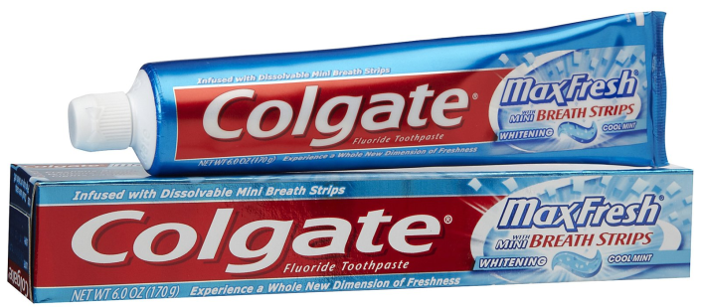
Definition of mass markets and niche markets
Mass market – this is the market that is aimed at the general population e.g. regular toothpaste
Niche market – this is a subset of the main market and addresses a specialist need e.g. Sensodyne toothpaste for sensitive teeth

Slide 7
Activity Imagine this circle is the entire market for watches. How would it divide up with the different brands? How many brands can you think of?
Notes:
The market would not divide into 4 quarters, much more segmented into style, function, cost, etc. Swatch, Rotary, Omega, Tissot, Tag Heuer, Ice, see how many your group can come up with. Discussion now of which is a mass market watch and which is for a niche. Hopefully they will identify a Rolex as being a niche watch.

Slide 8
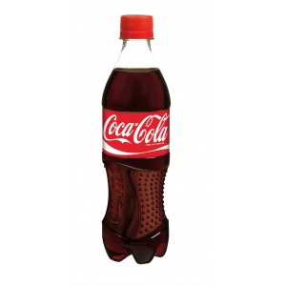
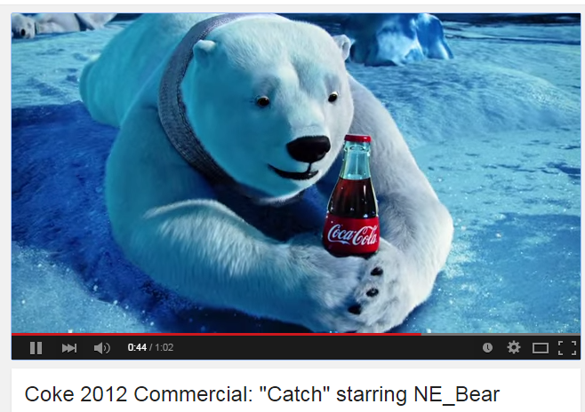
Mass market characteristics
A product is sold to all consumers in the same way. For example coca cola – one advert for everyone
Many products can be sold on a global scale with just a few language tweaks; Disney films, Microsoft software, Oreo Cookies

Slide 9
Mass Market examples
The small car market in the UK is and example of the mass market
Consumers are not brand loyal in this market, they choose a car based on a logical comparison of features, engine and price
In comparison the premium car market is a niche market
Consumers are very brand loyal, for example they may be a “BMW person” or a “Mercedes fan”
Read more here

Slide 10
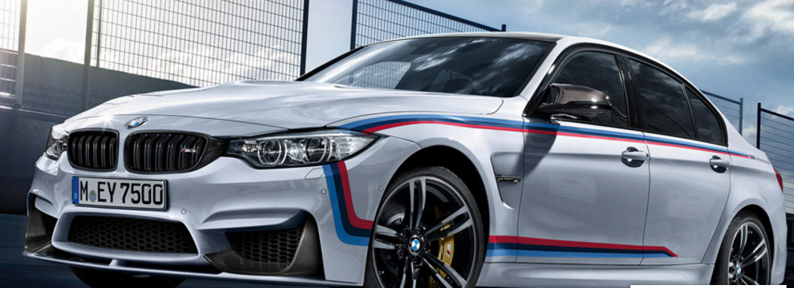
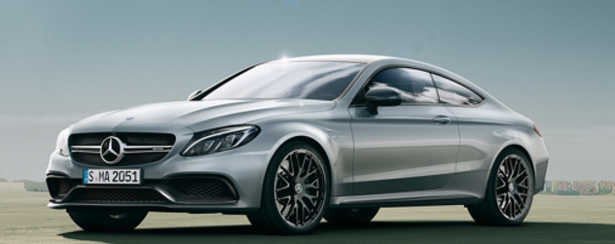
BMW or Mercedes – which are you?

Slide 11
Mass market pros and cons
Pros
Large scale production means economies of scale and lower average unit costs
Mass marketing is straightforward as everyone is equally targeted
Large volume of sales means high revenues
High revenues can be pumped into R&D
Cons
Lots of competition
Homogenous products need to be differentiated thorough marketing which can be expensive
High volume production not flexible to demand changes

Slide 12
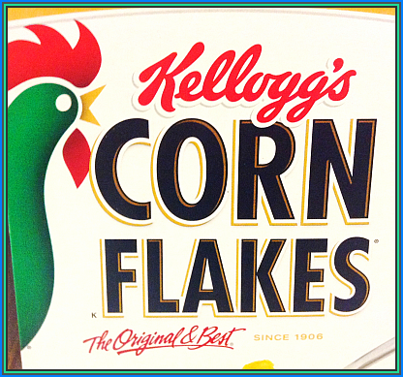
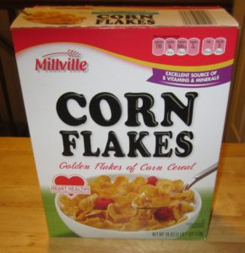
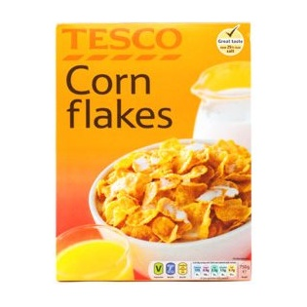
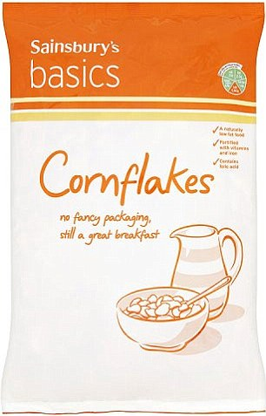
Mass market brands
Branding is very important in mass marketing to instil loyalty in customers, but not all mass markets rely on branding (small car market)
IN mass markets the products are homogenous (all the same) so they differentiate on branding
Kellogg's corn flakes
Heinz Ketchup
Are there any other brands you insist on?

Slide 13
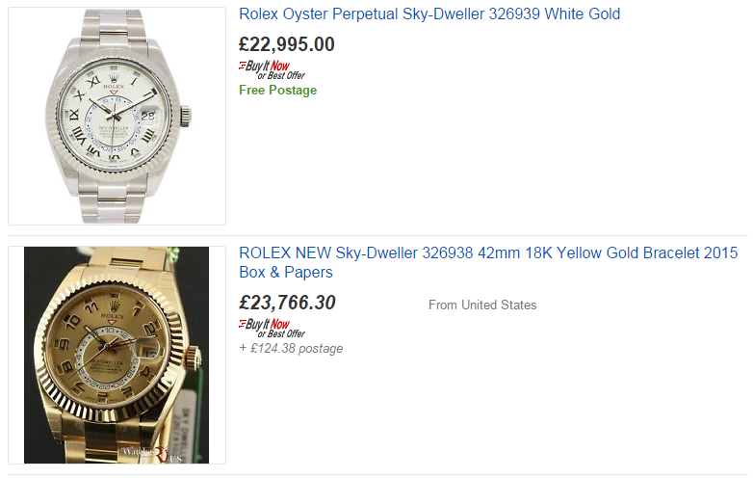
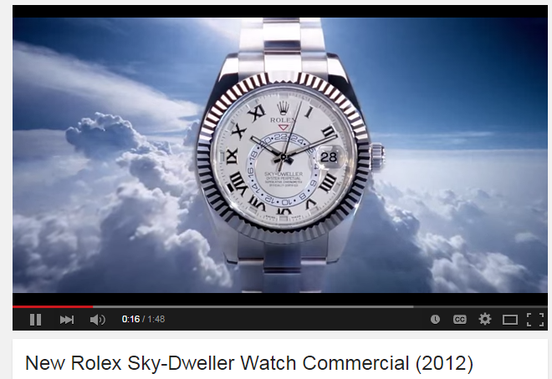
Niche market characteristics
This is a subset of the main market and caters to a particular segment of the market that is not being met by other providers e.g. Rolex
What the advert, who do you think this watch is aimed at?
Are you planning to spend £22,000 on a watch?
Will everyone buy one?

Slide 14
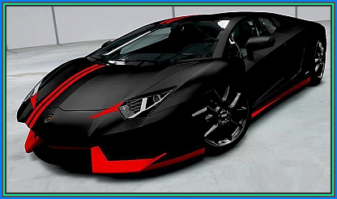
Niche market brands
How many Niche market supercar brands can you name?
Many niche markets in the car market, mainly at the top end. Customers are looking for a very special car that will turn heads, attract attention, give the owner kudos and also have a very fast engine.

Slide 15
Niche market pros and cons
Pros
Charge premium price
Easier to target customers
Small scale production can be flexible and follow trends
Less competition than in the mass markets
Cons
Very risky as demand may not be constant
Higher unit costs so no economies of scale
Example: Tokyo old cameras

Slide 16
Niche markets
These can be profitable markets to be in, often prices charged are higher as consumers in that niche are willing to pay for exactly the right product.
The profits can often signal more competitors to enter the market
Businesses in niche markets often have a small range of products which make them more risky ventures
There can be a problem of the lack of economies of scale as not enough products are sold for the business to be viable
Additionally the market for some more expensive items may be very limited

Slide 17
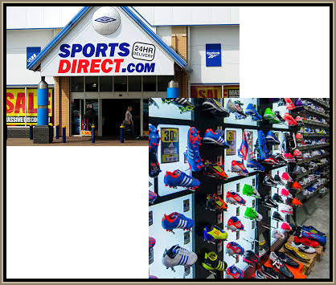
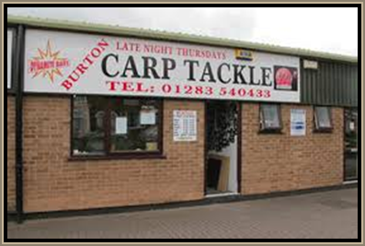
Example of Mass vs Niche
Fishing tackle shop – niche marketing caters to those who want to fish only
Sports Direct example of mass market retailer – caters to everyone

Slide 18
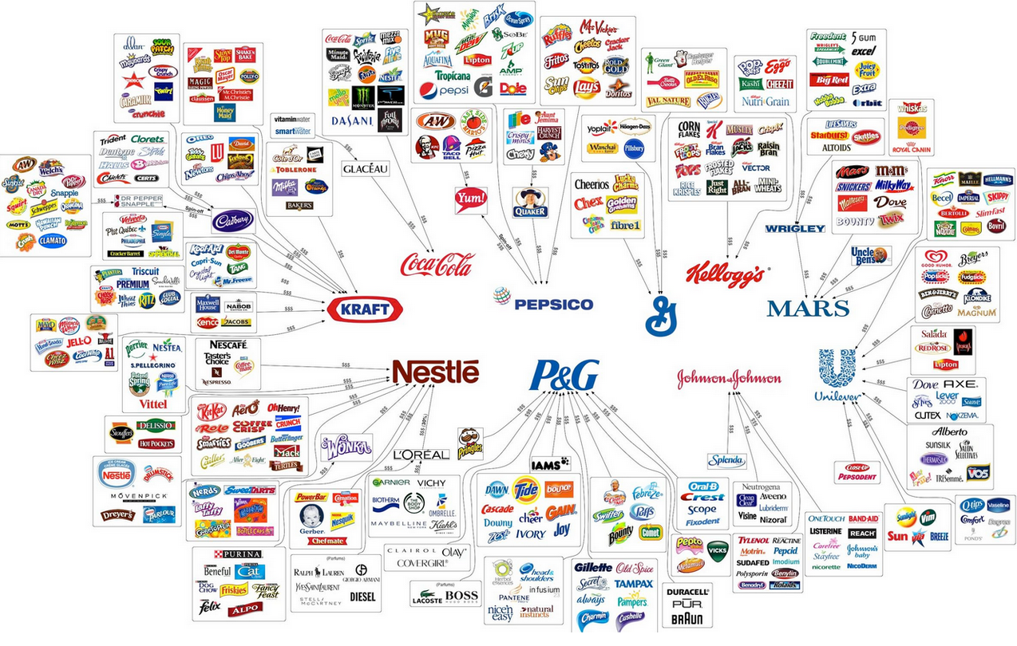
The illusion of choice – 10 big companies manufacture most of the mass market brands
Notes:
http://1.bp.blogspot.com/-hRlj6LuMF3E/UMXnjFUKwyI/AAAAAAAAA5I/hYUi-Jv9G5c/s1600/10corporationsillusionofchoice.PNG
Bigger on the main screen

Slide 19
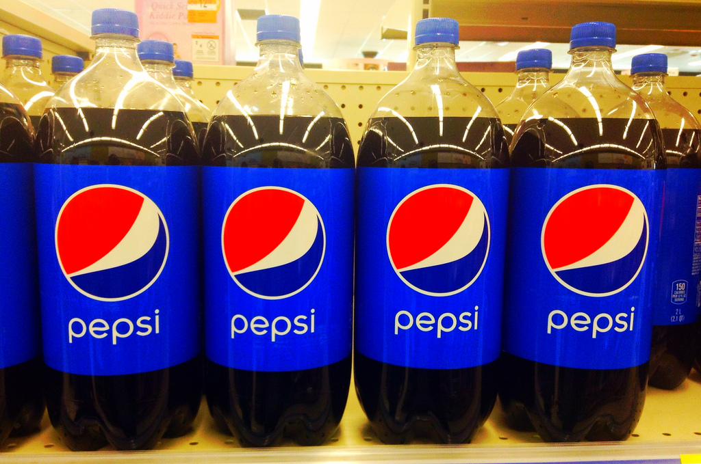
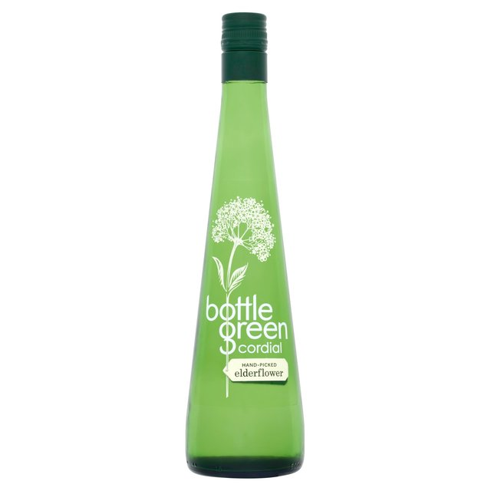
Mass or niche?
Notes:
Answer Pepsi is mass market

Slide 20
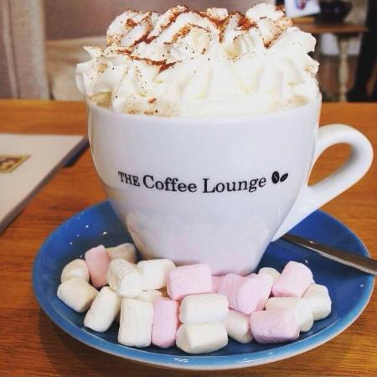
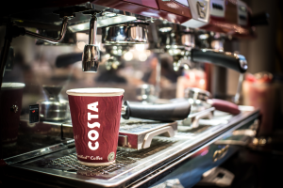
Mass or Niche?
Notes:
Answer Costa coffee is mass market

Slide 21
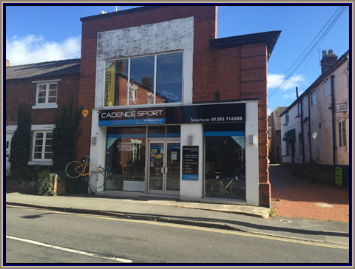
Mass or niche?
Notes:
Answer JD sports is mass market

Slide 22
Market size
The size of the market is the TOTAL of all the sales of all the producers in that market
This can be measured two ways:
Volume of sales, or quantity of products sold e.g. 91 million burgers sold every year**
2. Value, total amount spent by customers e.g. The UK burger bar market is estimated to be worth £3.28billion in 2016*
Notes:
*https://www.thecaterer.com/articles/368295/uk-burger-market-worth-328b
**This is just Big Macs - http://www.mcdonalds.co.uk/ukhome/whatmakesmcdonalds/questions/running-the-business/burgers/how-many-beef-burgers-do-you-sell-in-one-year.html
Whole market data is hard to com by

Slide 23
What does a business do with the information about market size?
Coca Cola has 24% of UK soft drinks market
Market value of soft drinks in the United Kingdom (UK) from 2012 to 2017 (in million euros)

Slide 24
What does a business do with the information about market size?
Coca Cola can look at the data and decide if the market is expanding or contracting (look at the chart on the last slide – what do you think is happening?)
Coca cola can calculate their market share in relation to competitors
Coca cola can look at other markets and see if they are worth entering
Coca Cola has 24% of UK soft drinks market

Slide 25
Market share
This means the proportion (%) of a market that is taken by a business, product or brand. It is calculated using the following formula:
$\frac{Sales of x}{\text{Total} \text{sales} \text{in} \text{whole} \text{market} }$ x 100
Coca Cola has 24% of UK soft drinks market

Slide 26
Problems of having a small market share
In this example Kettle Chips have a small market share
This could be a problem for Kettle:
No EOS
Vulnerable to failure
Less brand recognition / loyalty
Notes:
Taken from an A Level Edexcel new spec sample question (Not AS)

Slide 27
Dynamic markets

Slide 28
Definition of dynamic market
Dynamic market – one that is subject to rapid or continuous changes e.g. shoes

Slide 29
Dynamic markets – how markets change Was there always a market for these products?

Slide 30
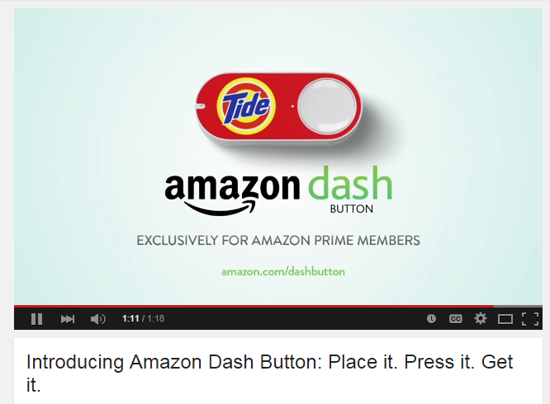
Dynamic markets – Innovation and market growth
Notes:
If you wish to do more with this the article is here to print out: http://news.sky.com/story/1456929/amazon-dash-button-how-does-it-all-work

Slide 31
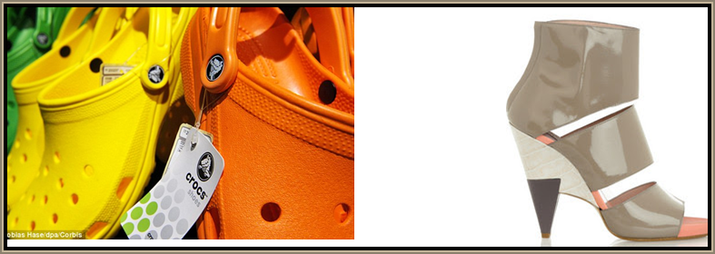
Dynamic market – which shoes do you prefer?
As tastes in fashion change rapidly so products are made to satisfy these new needs.
Businesses need to be one step ahead of the competition (this is why fashion shows are important as they predict trends for the following year)

Slide 32
Dynamic markets - Online retailing
Online retailing is a dynamic market because it is constantly changing, developing, expanding and offering customers new products and new ways to shop.
Amazon founded 1994
Ebay founded 1995
Etsy founded 2005
Some online retailers are only on the Internet.
Some (like Argos, Next, Evans, BHS, Debenhams) were retail stores first and then developed websites

Slide 33
Discussion
What do you think might happen in the next 10 years?
Will shopping be all online?

Slide 34
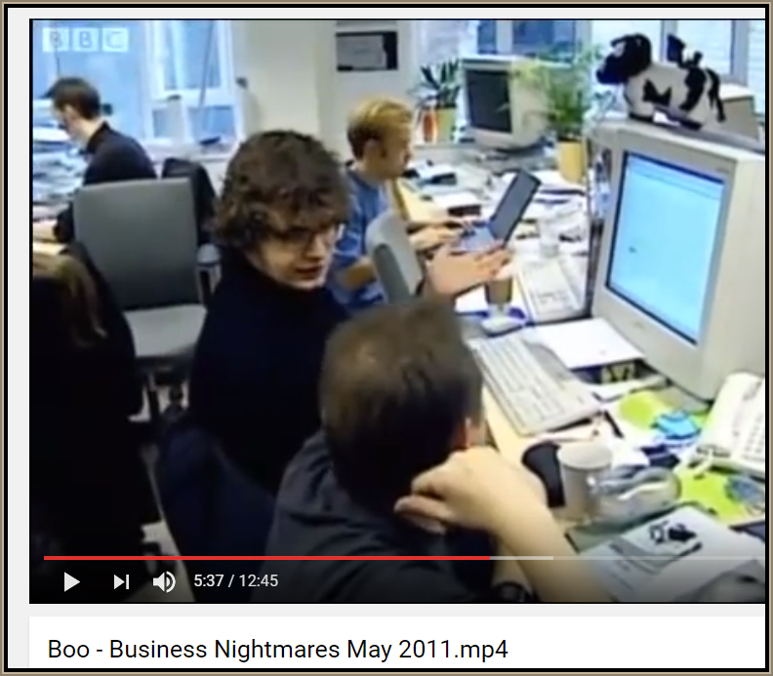
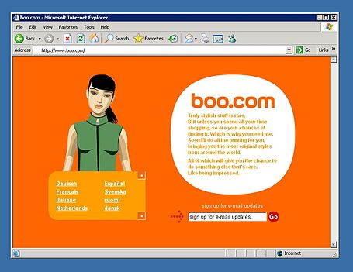
Dynamic market example – BooHoo .com
A dynamic market is not always good news for the online retailer: Boo.com was a UK Internet company launched in 1999, after spending £100 million venture capital it went bust in 2000 after just 18 months of trading

Slide 35
Advantages and disadvantages of online retailing
Advantages
Disadvantages

Slide 36
Advantages of online retailing
Shop is open round the clock
Orders can be taken automatically without the need for staff
Shop can reach international markets easily
Low overheads, no need for a shop premises
Stock can be easily withdrawn or updated to keep up with dynamic market changes in tastes
Easy to set up (eBay)
Flexible – owner can be anywhere in world
Opportunities for fast growth

Slide 37
Disadvantages of online retailing
71% of customers still prefer to browse online then purchase from a shop*
Issues with sending goods back may put customers off
Issues with online security worries put off older customers not keen to share their bank details
Very competitive market, hard to drive traffic to sites
Owners need IT skills
Problems with fraud / spam / viruses
Competitors can be aware of owners business model, prices, activity
Notes:
* Source Mail online article: http://www.dailymail.co.uk/femail/article-3031720/No-wonder-moans-Infographic-reveals-women-10-steps-FORTY-HOURS-making-purchase-shopping.html

Slide 38
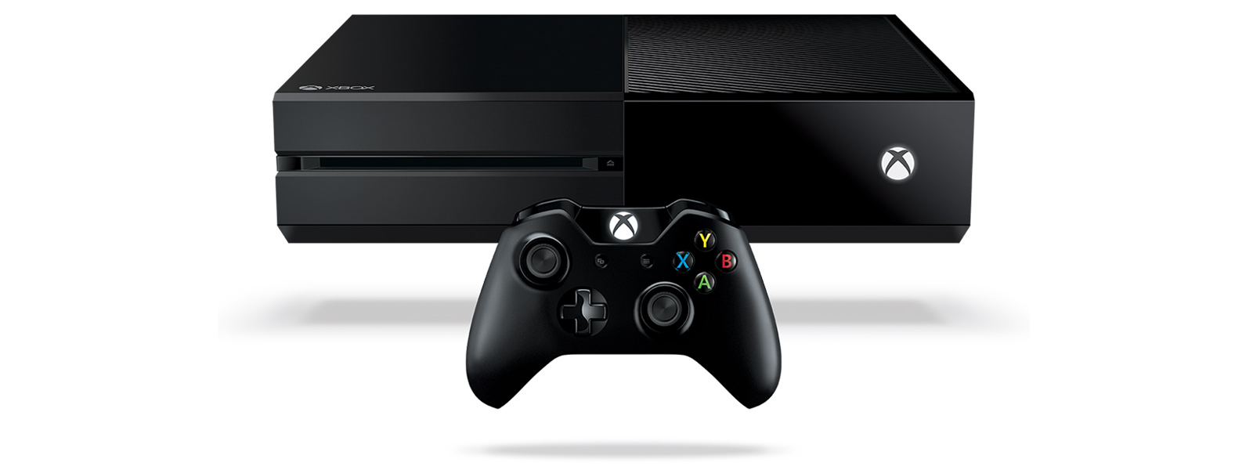
Market growth
With dynamic markets, comes constantly changing consumer tastes and preferences
Products not used widely 20 years ago:
Internet
Mobile Phones
PC computers for home use
Computer games / games consoles
Technology is a massive growth market, consider how many of these items are in most UK households now
For example, the increase of migrants to the UK has increased the need for speciality meats such as Kosher and Halal. These are growth markets and great opportunities for business

Slide 39
How competition affects the market

Slide 40
Competition and the market
Very competitive markets benefit the consumer in a number of ways:
More competition means a business needs to be very efficient
More competition means the business needs to listen to consumer needs and wants and constantly strive to meet those needs rather than being product orientated
More competition means a business must be less wasteful
With so much competition for loans and insurance, comparison websites have become essential to help customers navigate the promotional deals

Slide 41
Competition and the market
More competition means a business must produce a good quality product or service
More competition in homogenous markets means that businesses must complete on non-price factors, meaning lots of exciting promotions to persuade consumers to switch supplier or product

Slide 42
The difference between risk and uncertainty

Slide 43
Definition of Risk
Business risk is the possibility a business will have lower than anticipated profits or experience a loss rather than taking a profit
Business risk is influenced by; raw material costs, competition, the overall economic climate and government laws e.g. minimum wage

Slide 44
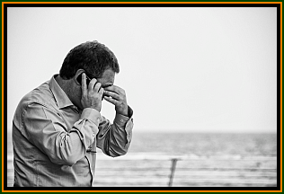
Risk – lack of job security
When a person starts a business they may leave behind a secure job
The risk of business failure means the business owner may not be able to meet their own financial bills
They may have a mortgage, a car and other bills to pay

Slide 45
Risk – financial risk
A business owner may put their own savings or finances into the business, this could be lost if the business fails
If the business is too highly geared (dependent on debt) then it may have difficulty if interest rates rise
Most businesses fail due to poor cash flow management
Cash flow can be improved by making sure that suppliers pay on time

Slide 46
Definition of Uncertainty
Uncertainty is when businesses are unable to predict external shocks or future events

Slide 47
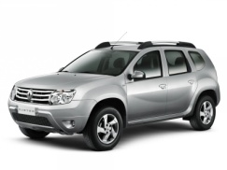
Uncertainty and spending decisions
As uncertainty about future economic conditions changes over time it can affect spending decisions:
If one company is taken over by another, the employees may feel more uncertain about whether next year’s pay will be higher or lower
Businesses may become more unsure about the level of next years’ orders if there is a change of government in one of their export markets
Households faced with uncertainty may save more rather than spend
Consumers may delay the purchase of a large item such as a car or house, these industries feel effects of shock and uncertainty the most
Companies may decide to delay an investment decision with a “wait and see” policy

Slide 48
Uncertainty
There is a degree of uncertainty in most business decisions
This is because the future cannot be predicted with any certainty, we cannot be 100% sure that any event will happen
Uncertainty increases with time; a forecast a week ahead will be more accurate than a year ahead
Tsunami in Japan had an impact on Toyota, the wave took out the factory where all the Toyota car parts were made

Slide 49
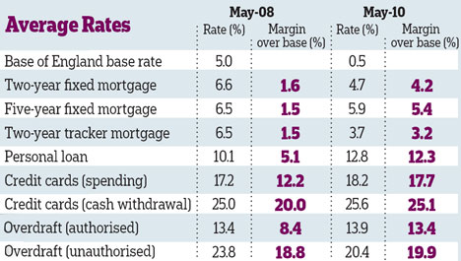
How a business may protect itself from uncertainty
A business may worry about fluctuating interest rates and so may take out a long term loan at a FIXED rate of interest
This means that loan payments stay the same each month and the business knows its fixed costs each month will not change

Slide 50
How a business may protect itself from uncertainly
A simple way is to take out insurance against risk
For example a DJ may have public liability insurance in case anything goes wrong with his equipment (like it catching fire)

Slide 51
Sample Edexcel A2 questions

Slide 52
Sample question 1
Knowledge 1
Application 3

Slide 53
Answer sample question 1

Slide 54
Sample question 2
Knowledge 1
Application 3

Slide 55
Answer sample question 2
TBC

Slide 56
Case study for question 3

Slide 57
Sample question 3
Knowledge 2
Application 2
Analysis
3
Evaluation
3

Slide 58
Answer sample question 2
2018

Slide 59
Case study for question 4

Slide 60
Sample question 4
Knowledge 1
Application 2
Analysis
1

Slide 61
Answer sample question 4

Slide 62
Case study for question 5

Slide 63
Sample question 5
Knowledge 1
Application 3

Slide 64
Answer sample question 5

Slide 65
Case study for question 6

Slide 66
Sample question 6
Knowledge 2
Application 2
Analysis
4
Evaluation 4

Slide 67
Answer sample question 6

Slide 68
Glossary
Mass market; products or services that are sold or advertised to everyone at the same time in the same way
Niche market; a subset of a normal market that caters for specific consumer needs and wants
Market size; measured by volume of sales or value
Market share; the % of a market that a business, product or service has
Innovation; when an invention is brought to market
Risk; this is the possibility that the business will have a lower than expected profit or a loss
Uncertainty; Uncertainty is when businesses are unable to predict external shocks or future events
Market growth; The percentage growth in the size of the market, measured over a specific period.

