Slide 1



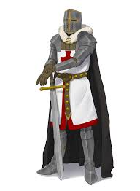


What will I learn this year in History?
AO1: Pre1066-1603
A02: The Norman Conquest
A03: The Crusades
What caused the Crusades?
How successful was the 1st Crusade?
What caused other Crusades to fail?
A04: Tudor England
Who were the contender for the throne in 1066?
Why did William win the Battle of Hastings?
How did England change under the Normans?
How did Henry Tudor become king?
Why did Henry break with Rome?
How did Henry’s children rule England?
A01/2/3: Pre-1066
A03: Challenges to the Crown
A04: Life in Medieval England
What do the sources tell us about life in medieval England?
What caused the Black Death?
Why did the Peasants’ Revolt?
What skills does a good historian need?
How did invasions change Britain?
Who are the Northern saints?
How powerful was the Medieval Church?
Why was Thomas Becket murdered?
Why did John sign the Magna Carta?
Assessment key; AO1: Historical Knowledge AO2: Causes, Consequence and Significant AO3: Source Analysis AO4: Evaluating interpretations

Slide 2
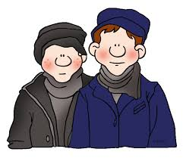




What will I learn this year in History?
AO1: 1603-1900
Working in Industrial Britain
Why did the domestic system end?
What do the sources tell us about conditions in factories and mills?
How did reformers try to improve factory conditions?
The rise of the British Empire
The English Civil War
How did the British gain an empire?
What do the sources tell us about life in the British Empire?
What impact has the British Empire had on our lives?
Why did the Civil War start?
Why did Parliament win the Civil war?
How did life change under Oliver Cromwell?
The Stuart Monarchy
Life in Early Modern Britain
Living in Industrial Britain
What was life like in an industrial town?
How were vaccinations developed?
Why did the population ‘explode’?
Was Guy Fawkes framed?
Why was King James I the ‘wisest fool in Christendom’?
Why was King Charles an unpopular monarch?
Why were the Stuarts so interested in Witches?
What do the sources tell us about the Pendle Witches?
Assessment key; AO1: Historical Knowledge AO2: Causes, Consequence and Significant AO3: Source Analysis AO4: Evaluating interpretations

Slide 3






What will I learn this year in History?
AO1: 1901-Present Day
A02: World War One
A03: Life in Nazi Germany
How did the Nazi's rise to power?
What do the sources tell us changes brought about in Germany?
How were people treated in Nazi Germany?
A04: Post War Conflict
What caused WWI?
How did warfare change during 1914-18?
How was life on the Homefront affected?
How did tension develop between the US and USSR?
Why was the US involved in Vietnam?
What was the impact of civil rights activism?
AO2: Suffragettes
A03: Peace and Reconciliation
A04: World War Two
What were the causes of WWI?
What experiences did people have of the Homefront?
Why did the US drop the A-Bomb?
How did women protest for the right to vote?
Did Emily Davison mean to kill herself?
Why were women granted the vote in 1918?
Why did the allies win WWI?
What were the aims of 'The Big Three'?
Why did the Treaty of Versailles fail to bring peace?
Assessment key; AO1: Historical Knowledge AO2: Causes, Consequence and Significant AO3: Source Analysis AO4: Evaluating interpretations

