Slide 1
World Book Day Thursday 7th March 2024

Slide 2
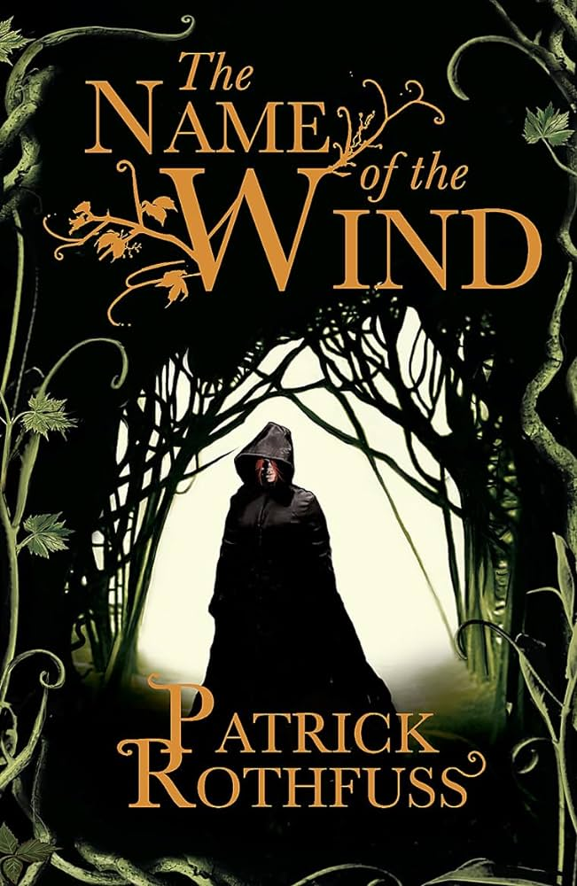
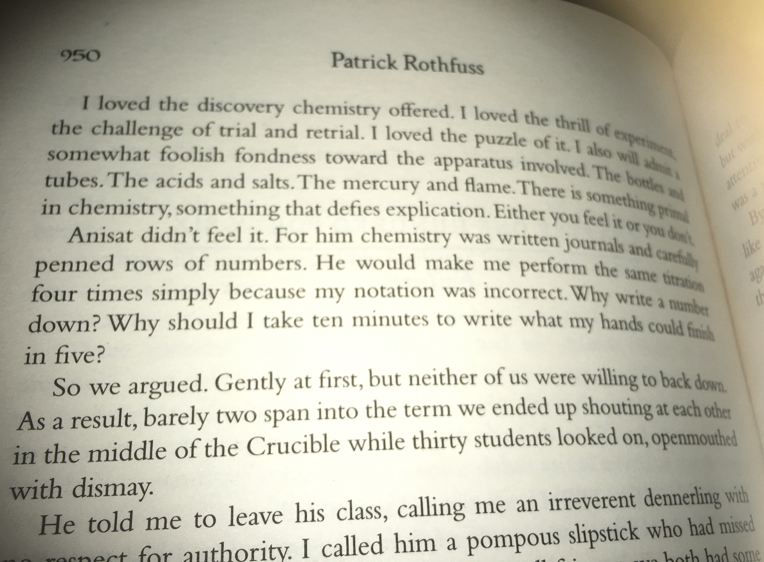
World Book Day
How does ‘The Name of the Wind’ link to our learning today?
Why does the narrator talk of a fondness for the apparatus? What does he mean?
What could the ‘penned rows of numbers’ refer to?
What do you think ‘two span’ might mean?
What do you think the setting is? Why is it called the ‘Crucible’?

Slide 3
World Book Day
Narrated by Death, the story follows Liesel Meminger, a young girl living with foster parents, Hans and Rosa Hubermann, in Nazi Germany during World War II. While adapting to her new home, she is exposed to the horrors of the war and politics. As the political situation in Germany deteriorates, her foster parents conceal a Jewish man named Max Vandenburg. Hans develops a close relationship with Liesel, helping her learn to read and write. Recognizing the power of writing and sharing literature, Liesel begins to steal books that the politicians are seeking to destroy.
How does ‘The Book Thief’ link to our learning today?

Slide 4
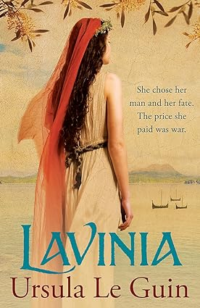
World Book Day
Lavinia is the daughter of the King of Latium, a victorious warrior who loves peace; she is her father's closest companion. Now of an age to wed, Lavinia's mother favours her own kinsman, King Turnus of Rutulia, handsome, heroic, everything a young girl should want. Instead, Lavinia dreams of mighty Aeneas, a man she has heard of only from a ghost of a poet, who comes to her in the gods' holy place and tells her of her future, and Aeneas' past...
If she refuses to wed Turnus, Lavinia knows she will start a war - but her fate was set the moment the poet appeared to her in a dream and told her of the adventurer who fled fallen Troy, holding his son's hand and carrying his father on his back...
How does ‘Lavinia’ link to our learning today?

Slide 5
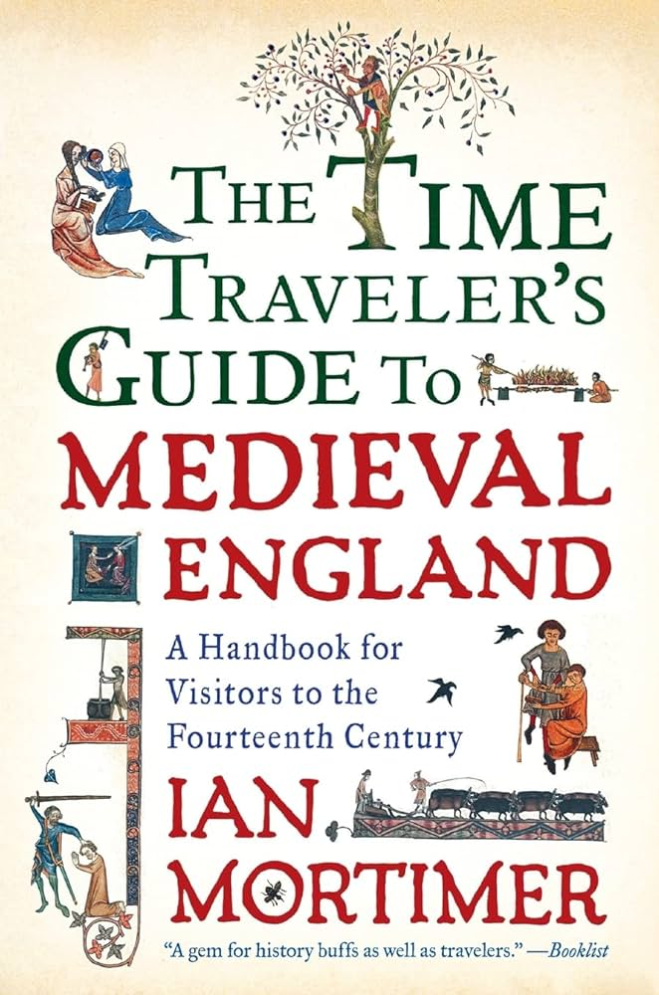
World Book Day
What does ‘The Time travelers guide to Medieval England’ Have to do with our learning today?
List 4 things you, as a visitor to a medieval town would be able to see/hear according to this book
Your nostrils will be invaded by the stench from the sewage-polluted watercourses and town ditches. After the natural quiet of the country road, the birdsong and the wind in the trees, your hearing must attune to the calls of travellers and town criers, the shouts of labourers and the ringing of church bells. In any town on a market day, or during a fair, you will find yourself being jostled by the crowds who come in from the country for the occasion, who live it up rowdily in the taverns. To visit an English town in the late fourteenth century is a bewildering and extreme sensory experience.

Slide 6
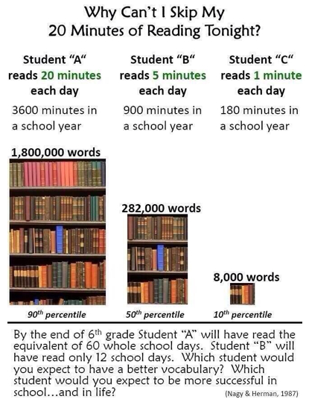
World Book Day
Yr13 Assembly on the benefits of reading every day:

Slide 7
World Book Day
Yr12 Form Assembly literature quiz

Slide 8
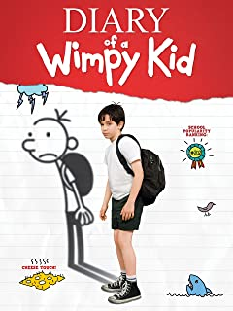
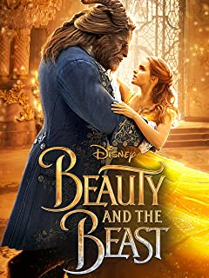
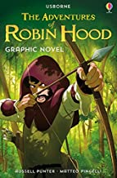
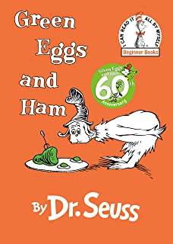
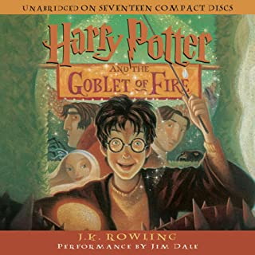
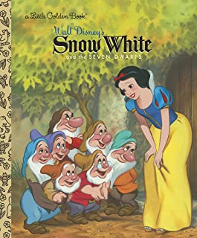
B
D
1. Le journal d’un dégonflé A
2. La Belle et la Bête D
3.Les aventures de Robin des Bois E
4. La chenille qui fait des trous J
5. Harry Potter et la chambre des
Secrets C
6. Harry Potter et la coupe de feu F
7. Le meilleur chien du monde H
8. Les larmes du crocodile B
9. L’énorme crocodile L
10. Le livre de la jungle I
11. Blanche Neige K
12. Les oeufs verts au jambon G
A
C
G
H
E
F
K
J
L
I

Slide 9
World Book Day
Work with a partner to translate as many of the book titles as you can into English.
Back of books!

Slide 10
World Book Day
Yr10 Geography reading on sustainability and the upcoming Geography trip to Barcelona.

Slide 11
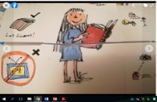
World Book Day
French lessons looked to Roald Dahl's 'Matilda' for inspiration when building up their vocabulary and putting their sentence construction and writing skills to the test.

